Slide 1



Performance testing meets
The Cloud

Slide 2
Another way to run
performance tests
on AWS

Slide 3

What is Performance Testing?

Slide 4
Wiki:
a testing practice
performed to determine
how a system performs
in terms of
responsiveness and stability
under a
particular workload
https://en.wikipedia.org/wiki/Software_performance_testing

Slide 5
Server
(system under load)
User 1
User 3
…
User n
User 2

Slide 6
Performance testing: standard approach
Define performance baseline (how many users we want to handle vs. expected response time)
Emulate many users simultaneously
Measure system responsiveness under load
Analyze the results
Update the target system
Re-run the test

Slide 7
Performance testing: best practices
Users should be different, i.e. sending unique (not hardcoded) requests
Users should be geographically diversified
Performance testing should be done regularly

Slide 8
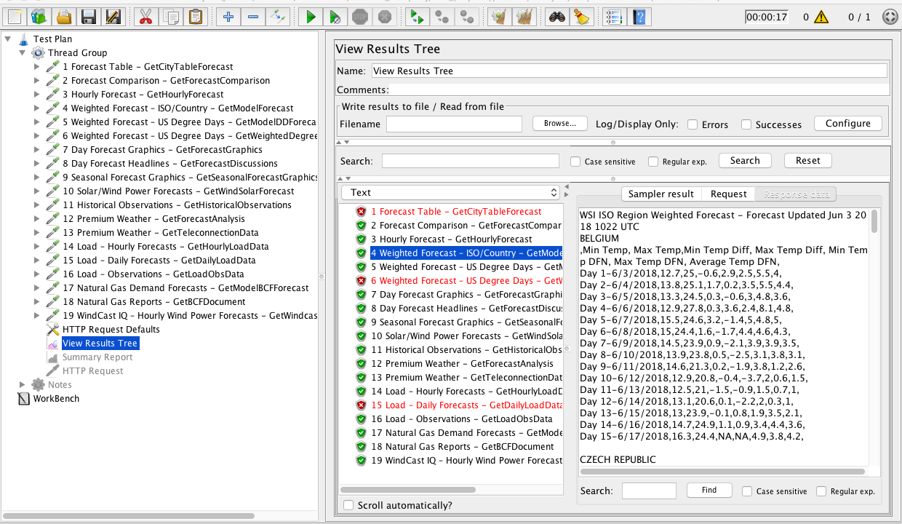
1. Emulate real users - JMeter

Slide 9
JMeter Pros:
Easy to start
Scripts to generate unique requests on the go (Groovy, Beanshell, etc.)
Collects performance metrics and generates pretty reports
Active community and plenty of extensions for non-trivial tasks
Allows distributed testing - important

Slide 10
JMeter Lacks:
Geographical diversity – all requests coming from the same region (throughput limitation)
Limited abilities of a single instance to generate load (memory issues)
Thus:
running tests with a single JMeter instance is not a proper performance testing

Slide 11
Solution:
Set up several JMeter instances in different regions (Amazon Web Services might help);
Run a distributed performance test with multiple JMeter instances.

Slide 12
Setting up an AWS EC2 instance with JMeter:
Set up Virtual Private Cloud;
Set up Subnet;
Set up Internet Gateway;
Set up Route Table and Association;
Set up Security Group;
Start Instance with public IP;
Install and configure JMeter (open ports, get IP).
Do that as many times as many instances you want.

Slide 13
Run distributed JMeter test in console:
jmeter -n -t load_script_name.jmx
-R 172.17.0.2,…,172.17.0.4 -l report_name.jtl

Slide 14
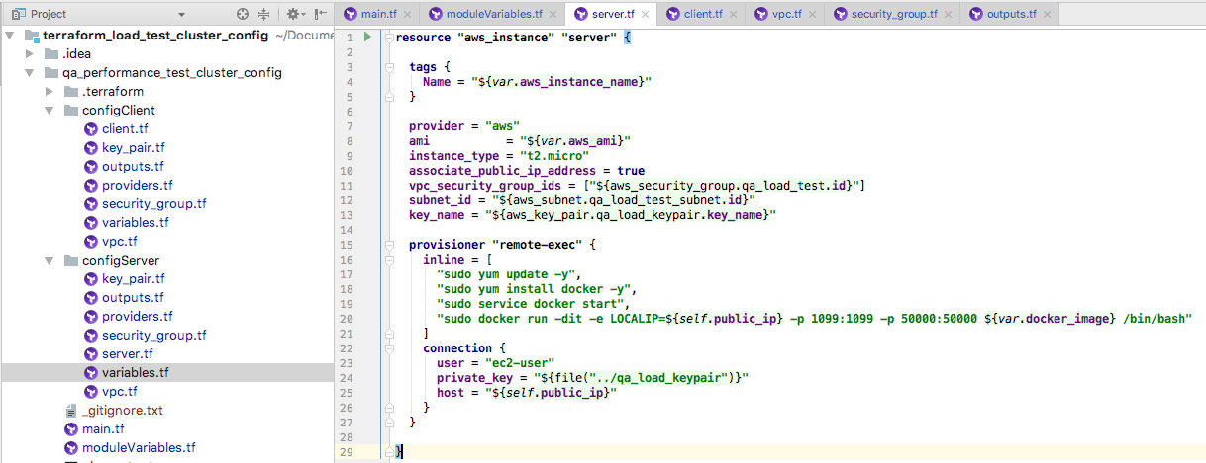
Take automation one step further?
Configure the AWS infrastructure automatically with Terraform:

Slide 15
Server (system under load)
Requests
Responses
…
JMeter
Slave 1
JMeter
Slave 2
JMeter
Slave n
Performance Stats
RMI Instructions
JMeter Master
Load Scenario
Performance Report

Slide 16
Before you run the whole thing:
Prerequisites:
Valid AWS credentials in ~/.aws/credentials file
Terraform tool installed (v0.11.2)

Slide 17
In the command line:
Clone project:
git clone https://github.com/artie-sh/performance_testing_terraform_aws_docker_jmeter.git
Enter the project folder:
cd performance_testing_terraform_aws_docker_jmeter

Slide 18
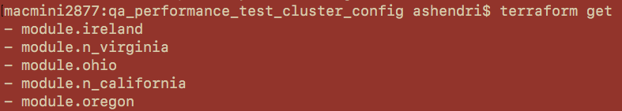
Initialize modules:
terraform get

Slide 19
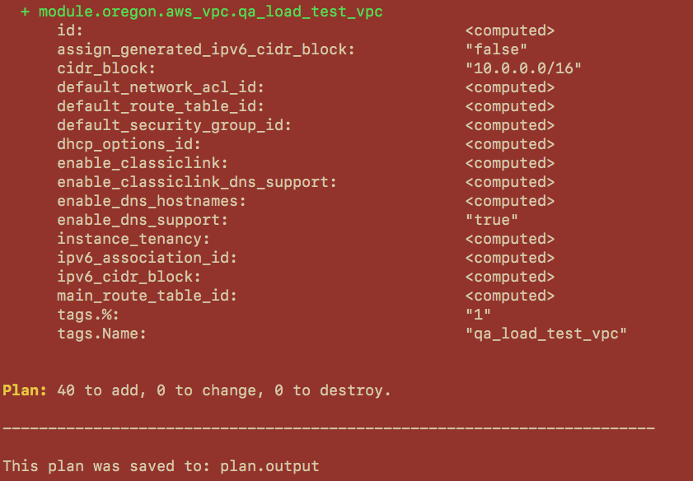
Plan the output: terraform plan -out plan.output

Slide 20
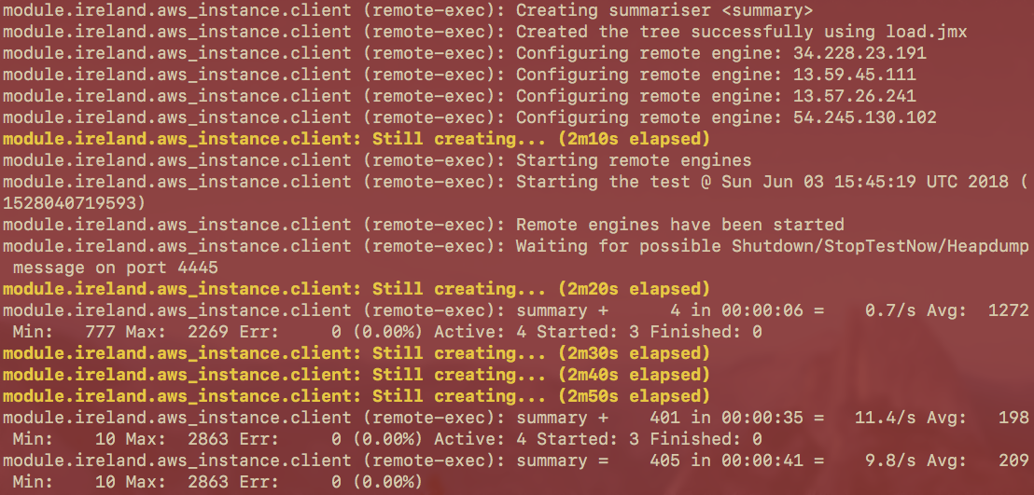
Apply the plan: terraform apply plan.output

Slide 21
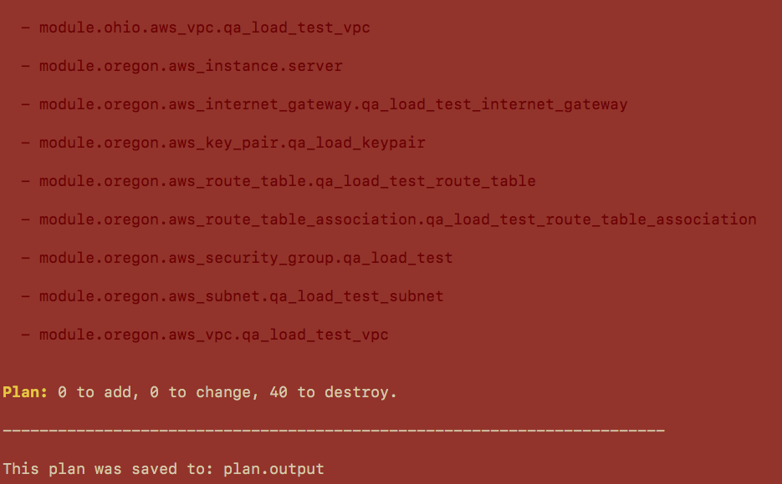
Destroy infrastructure after test is done:
terraform plan -destroy -out plan.output

Slide 22
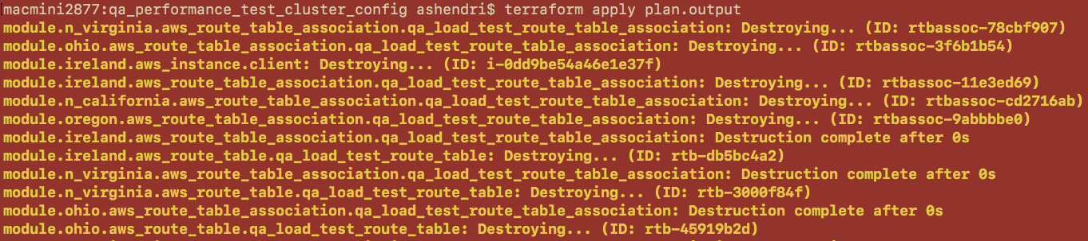
terraform apply plan.output

Slide 23
Header
content

Slide 24
See you on our next meeting in July!
05 / 07 / 2018

